Slide 1
Unit 5: Lecture : 9 and 10
Theory of Utility
CONTENTS
Introduction
Objectives
Basis of Choice: Utility
Cardinal and Ordinal Approach
Marginal Utility and Total Utility
Diminishing Utility

Slide 2
Introduction
There are millions of goods and services in the market places for households’ consumptions. Meanwhile households have limited resources to buy these goods for consumptions. Therefore households usually manage to sort out some set of goods and services out of million goods and services available. In choice making, relative worth of different goods and services are considered. This consideration is known as satisfaction, but to economist it is called utility.

Slide 3
OBJECTIVES
At the end of this unit, you should be able to:
define utility
understand the concept of total utility
understand the concept of marginal utility
measurement of Utility-
make differences between cardinal and ordinal approach
The Law of Diminishing Marginal Utility

Slide 4
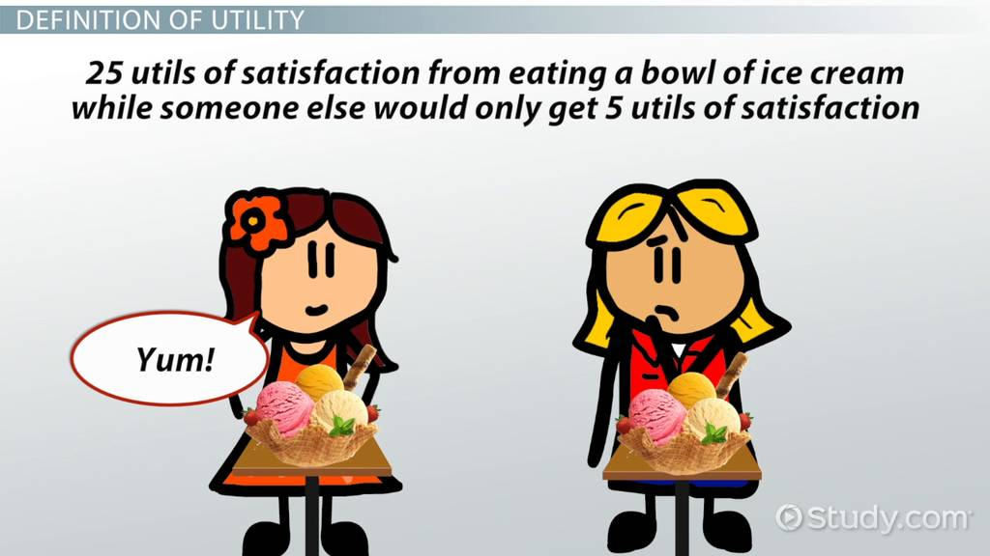
Utility- Meaning
From Commodity Point of View:
From Consumer’s Point of View:
Want satisfying power of a commodity.
Psychological felling of satisfaction, pleasure, happiness or well- being which a consumer derives from the consumption of a commodity

Slide 5
Concept of utility: The demand for a commodity depends on consumer behavior. People tend to choose those goods and services they value most highly. Sometimes price are often fail to reflect the usefulness of goods. Goods like water and salt, without which human beings would perish, have low relative prices while goods that have little practical value, such as diamonds, gold, and high fashion, have relative prices.

Slide 6
The more there is of a commodity, the less is the relative desirability of its last little unit. It is therefore clear why water has a low price and why an absolute necessity like air can become a free good. In both cases, it is the large quantities that pull the marginal utilities so far down and thus reduce the prices of these vital commodities.

Slide 7
People’s preferences for goods and services are based on their perception of how the goods or services add to their utility.
Utility is the satisfaction that people enjoy from consuming goods and services.

Slide 8
Total utility:The overall satisfaction derived by a consumer from consumption of various units of a good or service, at a certain point or over a period, is known as total utility or alternately called as “full satiety.”
Sum of the utilities derived by consumer from the various units of goods and services.

Slide 9
Total Utility can be expressed as:
TU_{n} = U_{x} + U_{y} + U_{z} or TU = ƩMU
Where TU = Total Utility
n = Number of commodities
U_{x} , U_{y} , U_{z} = Total respective utilities of consumption of goods
MU = Marginal Utility

Slide 10
Marginal utility
The term ‘marginal’ refers to small change, and utility means satisfaction. So, as its name suggests marginal utility is the additional satisfaction received by a consumer, on the consumption of an extra unit of a commodity. It implies the addition to the total utility, due to the consumption of one more unit of a good or service.

Slide 11

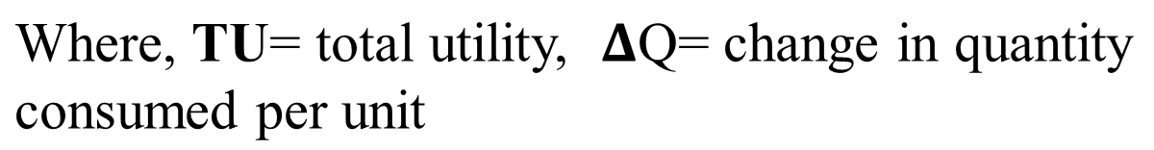
Marginal utility
Addition to the total utility resulting from the consumption of one additional unit.
Alternative way of expressing marginal utility when (n) is the number of units consumed, can be given as:
MU of nth unit = TU_{n} – TU_{n-1}

Slide 12
Relationship
Look at the below-given schedule and diagram, to understand three important relationships between total utility and marginal utility:
Units Consumed | Total Utility (TU) | Marginal Utility (MU)
1 | 30 | 30
2 | 56 | 26
3 | 76 | 20
4 | 88 | 12
5 | 90 | 2
6 | 90 | 0
7 | 86 | -4
8 | 78 | -8

Slide 13
Relationship
When the marginal utility is positive, total utility is increasing (from unit 1 to 5).
When the marginal utility is zero, total utility is maximum (At 6th unit).
When marginal utility is negative, total utility is decreasing (Unit 7 & 8)

Slide 14
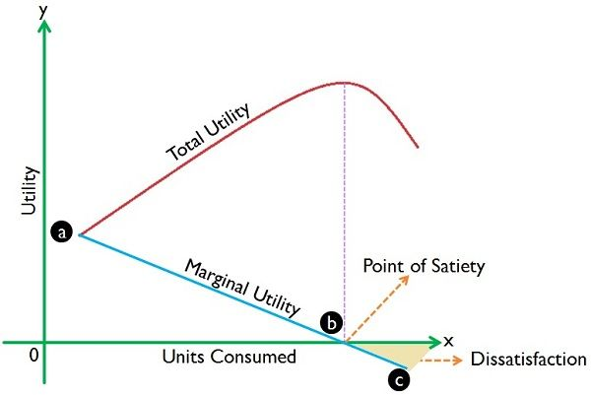
Graphically

Slide 15
Measurement of Utility-
The utility is a psychological phenomenon; that implies the satisfying power of a good or service. It differs from person to person, as it depends on a person’s mental attitude. The measurability of utility is always a matter of contention. But economists try to quantify the concept in two different ways:
cardinal utility and ordinal utility.

Slide 16
Comparison Chart
Basis for Comparison | Cardinal Utility | Ordinal Utility
Meaning | Cardinal utility is the utility wherein the satisfaction derived by the consumers from the consumption of good or service can be expressed numerically. | Ordinal utility states that the satisfaction which a consumer derives from the consumption of good or service cannot be expressed numerical units.
Approach | Quantitative | Qualitative
Realistic | Less | More
Measurement | Utils | Ranks
Analysis | Marginal Utility Analysis | Indifference Curve Analysis
Promoted by | Classical and Neo-classical Economists ie. based on the Marshallian School of thoughts. | Modern Economists ie.propounded by J.R Hicks and P.G.D Allen.

Slide 17
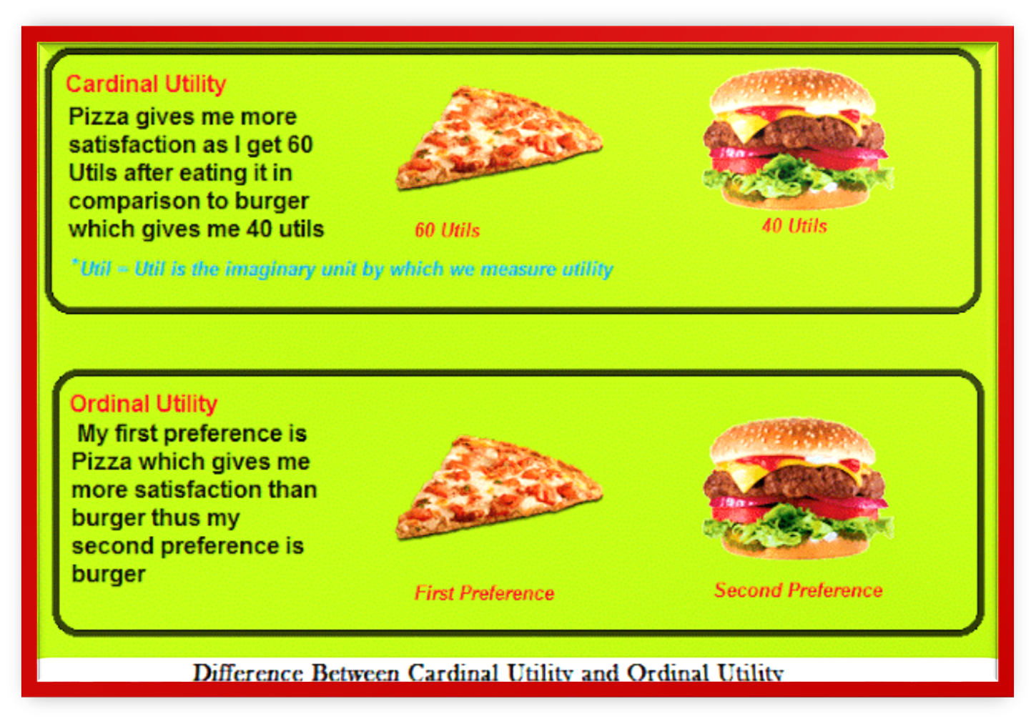
Comparison

Slide 18
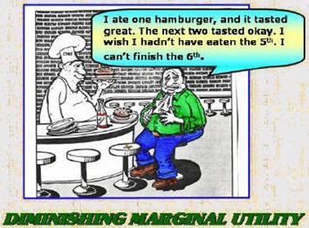
The Law of Diminishing Marginal Utility
The law of diminishing marginal utility says that the marginal utility from each additional unit declines as consumption increases.
The marginal utility can decline into negative utility, as it may become entirely unfavorable to consume another unit of any product.
This law applies to all kinds of consumer goods- durable and non-durable sooner or later

Slide 19
Assumptions:
Consumers are rational / Mental condition of the consumer must remain normal during the period of consumption .
Unit of the consumer good must be a standard one. e.g.- A cup of tea, a bottle of water (Same Shape & Size) / Goods are homogeneous .
Taste and habits are unchanged.
Consumption of goods should be continuous, any long gap in the consumption will alter the law.

Slide 20
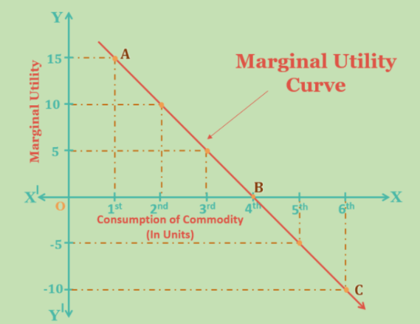
The Law of Diminishing Marginal Utility
Units of Pizza | T. U. | M. U.
1st | 15 | 15(15-0)
2nd | 25 | 10(25-15)
3rd | 30 | 5 (30-25)
4th | 30 | 0 (30-30)
5th | 25 | -5(25-30)
6th | 15 | – 10(15-25)

Slide 21
Limitations of the Law:
Suitable units
Suitable time
Change in consumer tastes

Slide 22
TUTOR-MARKED ASSIGNMENT
1.What is marginal utility?
2. Briefly explain the concept of diminishing marginal utility.
3. What is the basis of choice and in what unit is it measured?
4. What is the difference between marginal utility and total utility.

Slide 23
REFERENCES
Samuelson, P. A. & Nordhaus, W. D. (2010). Economics. (9th ed.). New York: McGraw Hill Companies.

Slide 24
THE PARADOX OF VALUE
How is it that water, which is essential to life, has little value, while diamonds, which are generally used for conspicuous consumption, command an exalted price?
The more there is of a commodity, the less is the relative desirability of its last little unit. It is therefore clear why water has a low price and why an absolute necessity like air can become a free good. In both cases, it is the large quantities that pull the marginal utilities so far down and thus reduce the prices of these vital commodities.

Slide 25
Consumer Surplus
The paradox of value emphasizes that the recorded money value of a good may be very misleading as an indicator of the total economic value of that good. The measured money value of the air we breath is zero, yet air’s contribution to welfare is immeasurably large. The gap between the total utility of a good and its total market value is called consumer surplus.

Slide 26
Consumer surplus
The surplus arises because we ‘receive more than we pay for’ as a result of the law of diminishing marginal utility. Consumer surplus is the excess of the total consumer benefit that a good provides ever what the consumers actually have to pay.
First developed by Jules Dupuit, French civil engineer and economist, in 1844 and popularized by British economist Alfred Marshall,

Slide 27
Consumer surplus
the concept depended on the assumption that degrees of consumer satisfaction (utility) are measurable. Because the utility yielded by each additional unit of a commodity usually decreases as the quantity purchased increases, and because the commodity’s price reflects only the utility of the last unit purchased rather than the utility of all units, the total utility will exceed total market value.

Slide 28
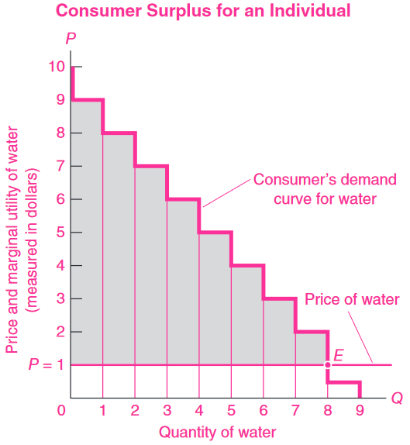
Consumer surplus
The downward-sloping demand for water reflects the diminishing marginal utility of water. Note how much excess or surplus satisfaction occurs from the earlier units. Adding up all the surpluses ($8 of surplus on unit 1 _x0002_ $7 of surplus on unit 2 _x0002_ . . . _x0002_ $1 of surplus on unit 8), we obtain the total consumer surplus of $36 on water purchases. In the simplified case seen here, the area between the demand curve and the price line is the total consumer
surplus.

Slide 29
Here, an individual consumes water, which has a price of $ 1 per gallon. This is shown by the horizontal rust line at $1 in the following figure. The consumer considers how many gallon jugs to buy at that price. The first gallon is highly valuable, slaking extreme thirst, and the consumer is willing to pay $9 for it. But this first gallon costs only the market price of $1, so the consumer has gained a surplus of $8.

Slide 30
Consider the second gallon, this is worth of $8 to the consumer, but again costs only $1, so the surplus is $7, and so on. The consumer equilibrium comes at point E, where 8 gallons of water are bought at a price of $1 each. Consumer has paid only $8, the total value of the water is $ 44. This is obtained by adding up each of the marginal utility column ($9 + $8-- +$2) = $44. Thus the consumer has gained a surplus of ($44 - $8) = $36 over the amount paid.

Slide 31
This is obtained by adding up each of the marginal utility column ($9 + $8-- +$2) = $44. Thus the consumer has gained a surplus of ($44 - $8) = $36 over the amount paid.

Slide 32
Applications of Consumer Surplus
Economists use consumer surplus when they are performing a cost benefit analysis, which attempts to determine the costs and benefits of a government program. Generally, an economist would recommend that a free road should be built if its total consumer surplus exceeds its costs. Similar analysis have been used for environmental questions such as whether to preserve wilderness areas for recreation or whether to require new pollution- abatement equipment.

Slide 33
Reference book
Samuelson,P.A. & Nordhaus, W. D. (2010). Economics. (9th ed.). New York: McGraw Hill Companies.

Slide 34
Definition of indifference Curve : The law of diminishing marginal utility does explain the law of demand but its claim to realism is limited. It requires that people be able to measure the utility they obtain by consuming various quantities of goods and services. Because of skepticism about the measurement of utility, economists were forced to find an alternative approach to understanding consumer behavior. The culmination of this search is indifference curve theory. This theory does not require that consumers be able to measure utility in any specific units of measurement but does assumes that consumers are able to rank their preferences for combinations of goods.

Slide 35
On the basis of a consumers scale of preferences, we can draw indifference curves. Other things remaining the same, an indifference curve represents satisfaction of a consumer from two commodities. It is drawn on the assumption that for all possible points on an indifference curve, the total satisfaction remains the same, hence, consumer is indifferent as to the combinations lying on an indifference curve. To draw the indifference curve, consider the following table :

Slide 36
Combinations | Apples | Mangoes | Marginal Rate of Substitution
A | 1 | 7 | ------
B | 2 | 4 | 1:3
C | 3 | 2 | 1:2
D | 4 | 1 | 1:1

Slide 37
A consumer who wants to buy apples and mangoes, he knows it well that one combination of apples and mangoes give him as much satisfaction as another combination of less apples and more mangoes or another combination of more apples and less mangoes give him the same satisfaction, so consumer is indifferent between the combinations. Now we draw the indifference curve from the indifference schedule.

Slide 38
In the following figure, the horizontal axis measures the quantity of apples consumed and vertical axis measures the quantity of mangoes consumed by the individual.
Quantity of Mangoes
I
7 a(7,1)
4 b(4,2)
2 c (2,3)
d( 1,4)
1
I
1 2 3 4
0
Quantity of Apples

Slide 39
On the figure, at point a, 7 units of mangoes and 1 unit apples are consumed. At point a, the consumer is willing to give up 3 unit of mangoes for more 1 unit of apples. This trade-off would move the consumer to point b, where 4 units of mangoes and 2 units of apples are consumed. At point b, the consumer is no longer willing to give up 3 units of mangoes to acquire 1 more unit of apple. The consumer is now willing to give up only 2 unit of mangoes to acquire more 1 unit of apple. This trade-off would put the consumer at point c, consuming 2 units of mangoes and 3 units of apples. Finally to acquire 1 more unit of apples the consumer is willing now to give up only 1 unit of mango, moving the consumer to point d.

Slide 40
The consumer is indifferent between points, a, b, c, and d feels equally well off at any of these points. A curve II can be drawn from the point add a to d, which is called indifference curve.
An indifference curve is the locus of points particular combinations or bundles of goods which yield the same utility or satisfaction to the consumer, so consumer is indifferent as to the particular combination he consumes. An indifference curve is downward-sloping because as long as both goods yield satisfaction, more is better than less. The only way for the consumer’s satisfaction to stay the same when more of one good is consumed is to consume less of the other good.

Slide 41
Marginal Rate of Substitution : The marginal rate of substitution is how much of one good a person is just willing to give up to acquire one unit of another. Thus the marginal rate of substitution is just a fancy name for an acceptable trade-off between two goods for a person’s valuation of an additional unit of one good in terms of the other.
The marginal rate substitution is that as more of one good (Apple - A) is consumed, the amount of other good (Mango - B) that the consumer is willing to sacrifice for one more units of (Apple - A) declines. The slope of the tangent at any point on the indifference curve measures the marginal rate of substitution of mango - B for apple -A.

Slide 42
Properties of Indifference curve: Indifference curves have the following properties :
They are bowed out toward the origin, which reflects the law of diminishing marginal rate of substitution;
The consumer is better off when he or she moves to a higher indifference curve;
Indifference curves that show preferences between two goods from which consumers derive benefits are downward- sloping;
Indifference curves cannot intersect each other, because an intersection would indicate that the consumer is simultaneously worse off and better off.
Indifference curves do not move as a result of market circumstances.

Slide 43
Indifference Map : There is an infinite number of indifference curves for each consumer. There are three indifference curves for a particular consumer are shown in the following figure. The higher the indifference curve, the greater the well-being of the consumer. An indifference map shows all the indifference curves which rank the preferences of consumer. Combinations of goods lying on a higher indifference curve yield higher level of satisfaction and are preferred combinations of goods on a lower indifference curve yield a lower satisfaction. The indifference map shows that commodity bundle “f” is preferred to bundle “e” because the former is on a higher indifference curve. Indifference curve I₃ represents a higher level of satisfaction than I₂ represents a higher level than I₁. The level of satisfaction along each indifference curve is constant.

Slide 44
There are three indifference curves for a particular consumer are shown in the following figure.
Quantity of Mangoes
f
e
d
I₃
I₂
I₁
O
Quantity of Apples

Slide 45
Budget Line : A consumer’s position on an indifference curve is determined by the consumer’s budget. A rational consumer will, therefore, try to reach the highest possible indifference curve in order to obtain the highest possible level of satisfaction by his limited income. Our consumer will be governed by the amount of the money or income he has to spend on goods, and prices of the goods in the market. Let us begin with a simple example, consider a consumer who has a weekly income of $ 100 that is used to purchase only two goods, i.e., food and clothing. The price of a unit of food (P_{f}) is $ 10 and the price of a unit of clothing (P_{c} ) is $ 5.

Slide 46
The following table illustrate the various combinations of food and clothing that the consumer can purchase under these conditions.
Combinations | Units of Clothing per Week | Units of Food per Week
A | 20 | 0
B | 10 | 5
C | 0 | 10

Slide 47
Combinations A shows that an income of $100 permits the consumer to buy 20 units of clothing at price of $5, with nothing left over for food purchases. Combinations C shows the other extreme, when the consumer’s entire income goes to buy 10 units of food at price of $10, with nothing left over for clothing. The combination B shows that an income of $100 permits the consumer to buy 10 units of clothing at price of $5 and 5 units of food at price of $10. Above schedule put in the graph we get the budget line, MN.

Slide 48
Consumption of
Clothing per week
20 A(20,0)
M
10 B(10,5)
N C(0,10)
0 5 10
Consumption of
food per week
The budget line is all the combinations of goods the consumer is able to buy given a certain income set prices. The budget line shows the choices of consumer goods available to the consumer.

Slide 49
Consumer Equilibrium
Introduction / Main Idea :The consumer is said to be in equilibrium when he obtains the maximum possible satisfaction from his purchases, given the prices in the market and the amount of money he has for making purchases.

Slide 50
Assumptions: In order to explain how a consumer reaches equilibrium position, we shall make the following assumptions:
Our consumer has an indifference map showing his scale of preferences for various combinations of two goods, i.e., apples and mangoes. This scale of preferences remains the same throughout the analysis;
He has a given and constant amount of money to spend on the goods and if he does not spend it one good, he must spend it on the other;
Prices of the goods in the market are given and constant;
Each of the good is homogeneous and divisible; and
The consumer acts rationally, i.e., he tries to maximize his satisfaction.

Slide 51
Diagrammatic Analysis : Our consumer has an indifference map, shown in the following diagram. Suppose, the budget line facing the consumer is AM, given a certain amount of money he has to spend on apples and mangoes and the prices of apples and mangoes in the market. Any point not lying on this budget line cannot be possible equilibrium points, because his situation will not allow him to move the budget line. The consumer is able to locate any where on the budget line, but the rational consumer will select that consumption that falls on the highest attainable indifference curve.

Slide 52
Apples
A
N
H P
K IC₃
IC₂
R IC₁
0 Mangoes
M

Slide 53
The consumer is in equilibrium at point P, where he will be buying OR units of mangoes and OH units of apples. At point P, the consumer will maximize his satisfaction and be in equilibrium at that point where budget line touches or is tangent to an indifference curve. Such a point in our diagram is P which lies on indifference curve IC₂ . This is the highest indifference curve to which he can go, given the money and the prices of the goods in the market. Any combination other than P on the given budget line can be shown to give less satisfaction to the consumer, for all other points on the budget line must lie on indifference curves of a lower order than that on which P lies. If consumer chooses a combination of mangoes and apples represented by N, he will be on a lower indifference curve IC₁, and will thus be getting less satisfaction than when he chooses the point P and is on a higher indifference curve IC₂ and same in point K. Finally we can say, consumer equilibrium occur at only point P on the highest attainable indifference curve where the marginal rate of substitution is equals the price ratio.

Slide 54
Conditions of Equilibrium : Two conditions must be satisfied for a consumer to attain an equilibrium; such as
i) At equilibrium point, the budget line should be tangent to an indifference curve or MRS of one commodity for another should be equal to their relative prices, i.e.,
Price of mangoes
MRS of mangoes for apples =
Price of apples
which is called first-order condition or necessary condition.
ii) At the point of equilibrium, an indifference curve must be convex to the origin, i.e., at or near the point of equilibrium the MRS of mangoes for apples is decreasing, which is called second-order condition or sufficient condition.

